Slide 1

PENETRATION TESTING

Slide 2
ENTERPRISE NETWORKS

Slide 3
ENTERPRISE NETWORKS
For a penetration tester, it is certainly helpful to understand the basic functioning of an enterprise network.
Going into details would take a dedicated course.
We will mainly focus on introducing the basics and some common elements.

Slide 4
RELEVANT CONCEPT
No network can work without being supported by at least two devices: a SWITCH and a ROUTER.

Slide 5
Graphical Network Simulator 3

Slide 6
GNS3
A multi-platform network simulator/emulator
Initially developed by Jeremy Grossmann (thesis work)
Started a crowdfunding campaign for 35000$ to add extra features
Actually collected +600000$
Free and open source (under GPL-3)
Alternative to Cisco Packet Tracer

Slide 7
GNS3
GNS3 allows you to emulate network devices
switch, router, firewall, host, …
Devices are connected to build a network topology
Device images/firmware must be available
Free instances on the GNS3 repository
Proprietary ones must be obtained (e.g., buying them)
ATTENTION: GNS3 is quite hungry for resources (depends on what you emulate)

Slide 8
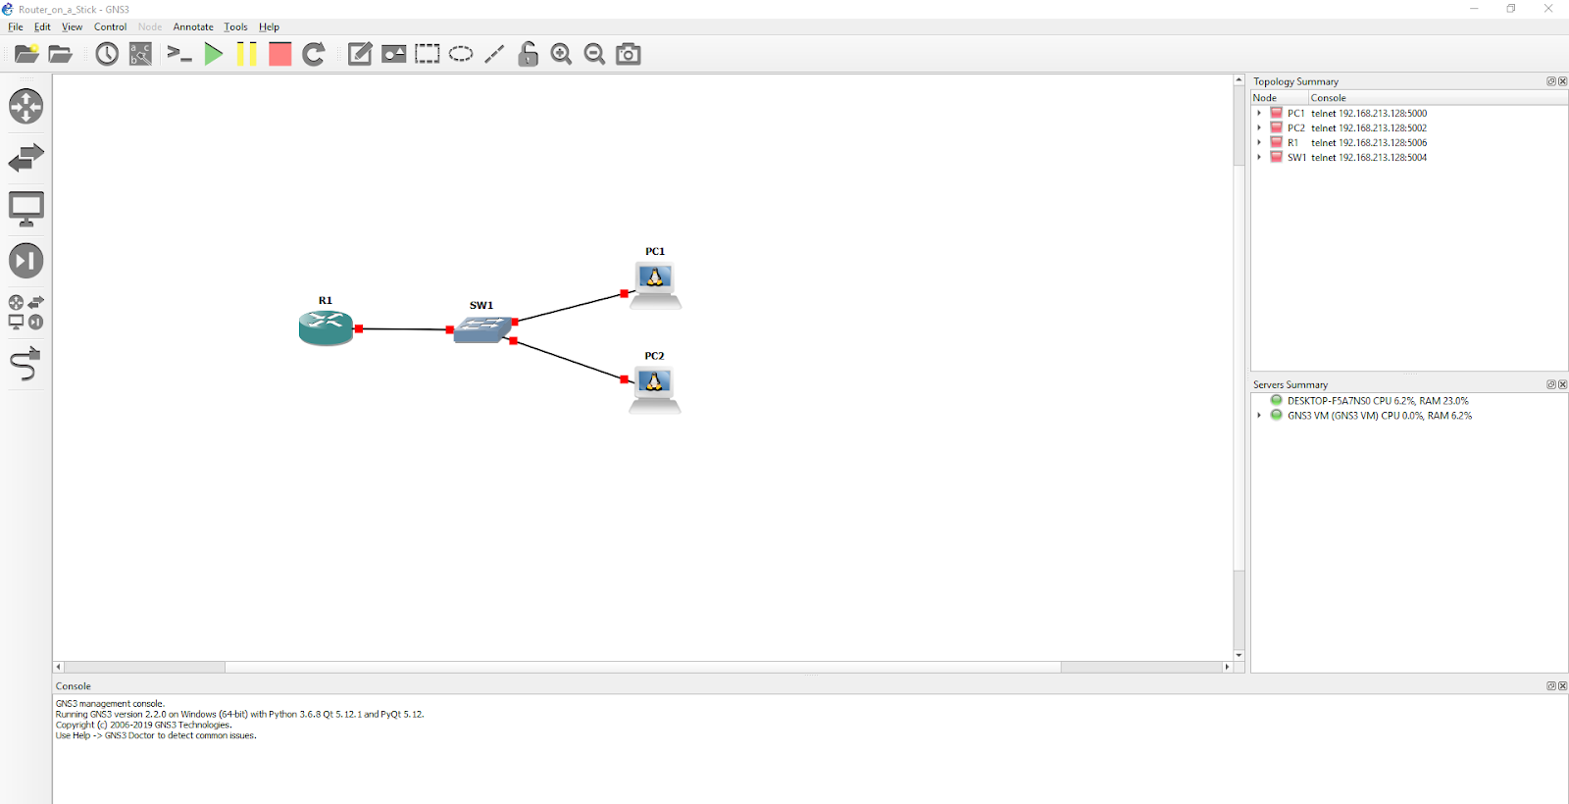
GNS3

Slide 9
GNS3
Installation
Go to https://www.gns3.com
Follow the instructions
try by yourself
check documentation and tutorials
mail me if you get stuck (-1 if the solution is #5 or less on Google!)

Slide 10
LAN - WAN - DMZ

Slide 11
LAN - WAN - DMZ
In order to interact with a medium/large network, we first need to define its topology.
We split our network into several areas, each characterized by some property.
This is called segmentation and helps to organize and manage the traffic passing through our network.

Slide 12
LAN - WAN - DMZ
The first distinction we need to make is between "internal world" and "external world".
By internal world we mean everything happening inside our private network, where our private IP addresses are assigned. This is called LAN (Local Area Network).

Slide 13
RELEVANT CONCEPT
When we need to communicate with the outside world (especially to connect to the Internet), we will refer to the WAN (Wide Area Network).

Slide 14
LAN - WAN - DMZ
This distinction helps us to emphasize, once again, the concept of "inside" and "outside".
We will almost never use only LAN and WAN. There are also other parts of the network that we will introduce for different purposes. One of these is the so called "DMZ", which means "demilitarized zone".

Slide 15
LAN - WAN - DMZ
In this area reside services that, although being “inside”, are exposed to the outside world. Precisely because of the implicit risks, the DMZ and LAN should have different security levels and be adequately protected.

Slide 16
LAN - WAN - DMZ
We can summarize this concept by saying that each network will always consist of a LAN part and a WAN part.
However, if necessary, we can add and define other portions of the network, like for example the DMZ.

Slide 17
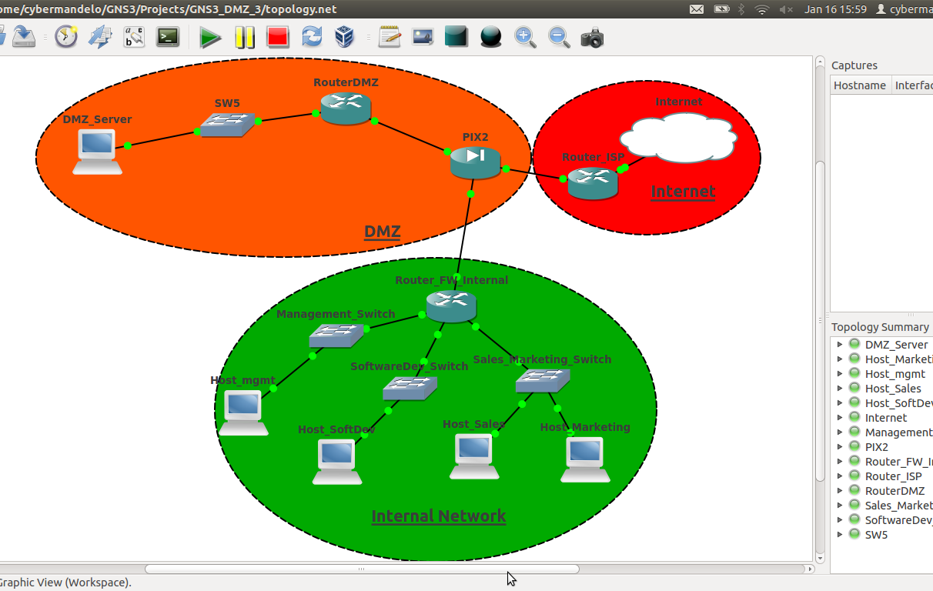
LAN - WAN - DMZ

Slide 18
THE SWITCH

Slide 19
RELEVANT CONCEPT
The switch is based on MAC addresses and works inside a specific subnet. Within a subnet we can find one or more switches.

Slide 20
THE SWITCH
A switch can never be connected to two or more subnets (as there would be the need to perform routing).
Each time more PCs need to communicate within the same subnet, we will have to insert and then configure a switch. This device is made up of several ports, which work as multiple network interfaces.

Slide 21
THE SWITCH
In each port, we can insert the network cable of the PCs that we want to communicate through the switch.

Slide 22
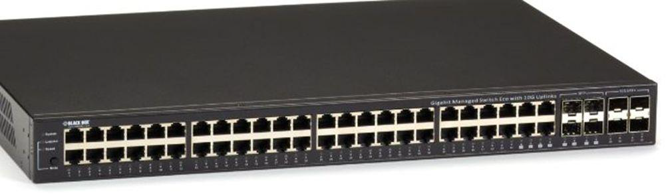
THE SWITCH

Slide 23
THE SWITCH
The packets sorted by the switch are called FRAME. One of the key features of the switch is its ability to forward packets in an efficient way.
A switch reads the destination MAC address contained in the Ethernet frames.
The MAC uniquely identifies a machine and, thus, a port in the switch.
Thus, minimal frame inspection is needed (just reading the MAC address) and no broadcastings (the recipient is connected through a wire).

Slide 24
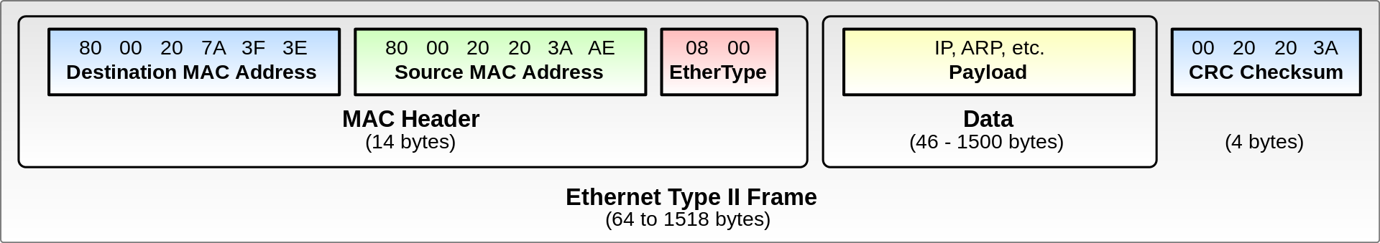
ETHERNET FRAME

Slide 25
THE SWITCH
Now let see the detailed process behind how this device works:
The switch automatically learns the topology of the LAN network. It can figure out to which of its ports each PC is connected.

Slide 26
THE SWITCH
It summarizes in a table, called the Content Addressable Memory (CAM) table, the associations between each port and MAC address. This table is then automatically updated every time new packets arrive.
If a frame from a new source A arrives from port P, then a binding (A,P) is added to the CAM table.

Slide 27
THE SWITCH
Moreover, when a frame arrives at a port, the switch checks whether the recipient's address is already present in the CAM table.

Slide 28
THE SWITCH
If the address is present but the recipient's port is different from the sender's, the packet is sent to the associated port and only to that one.
If not present, the packet is sent to all the ports, except for the sender’s one.

Slide 29
THE SWITCH
The switch has other more advanced features, such as MAC address filtering or other particular control operations.
For example, you can create a switch in GNS3 and connect some PCs to see how the LAN works.
(Note that you have to configure static IPs to ping the PCs)

Slide 30
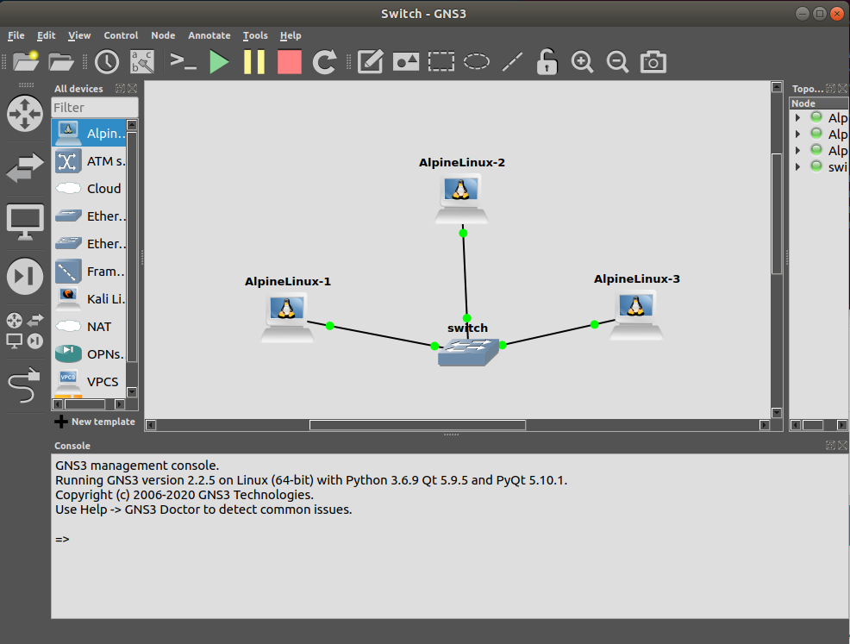
THE SWITCH

Slide 31
WIRESHARK

Slide 32
WIRESHARK
Before continuing with other network devices we need to make a digression
Most of the things that we want to observe right now are network communications
The best way to do this is through a network sniffer
A software that reads the traffic and allows us to inspect it
The best sniffer around is probably Wireshark (https://www.wireshark.org/)
Multi-platform, free and opens source, preinstalled on Kali

Slide 33
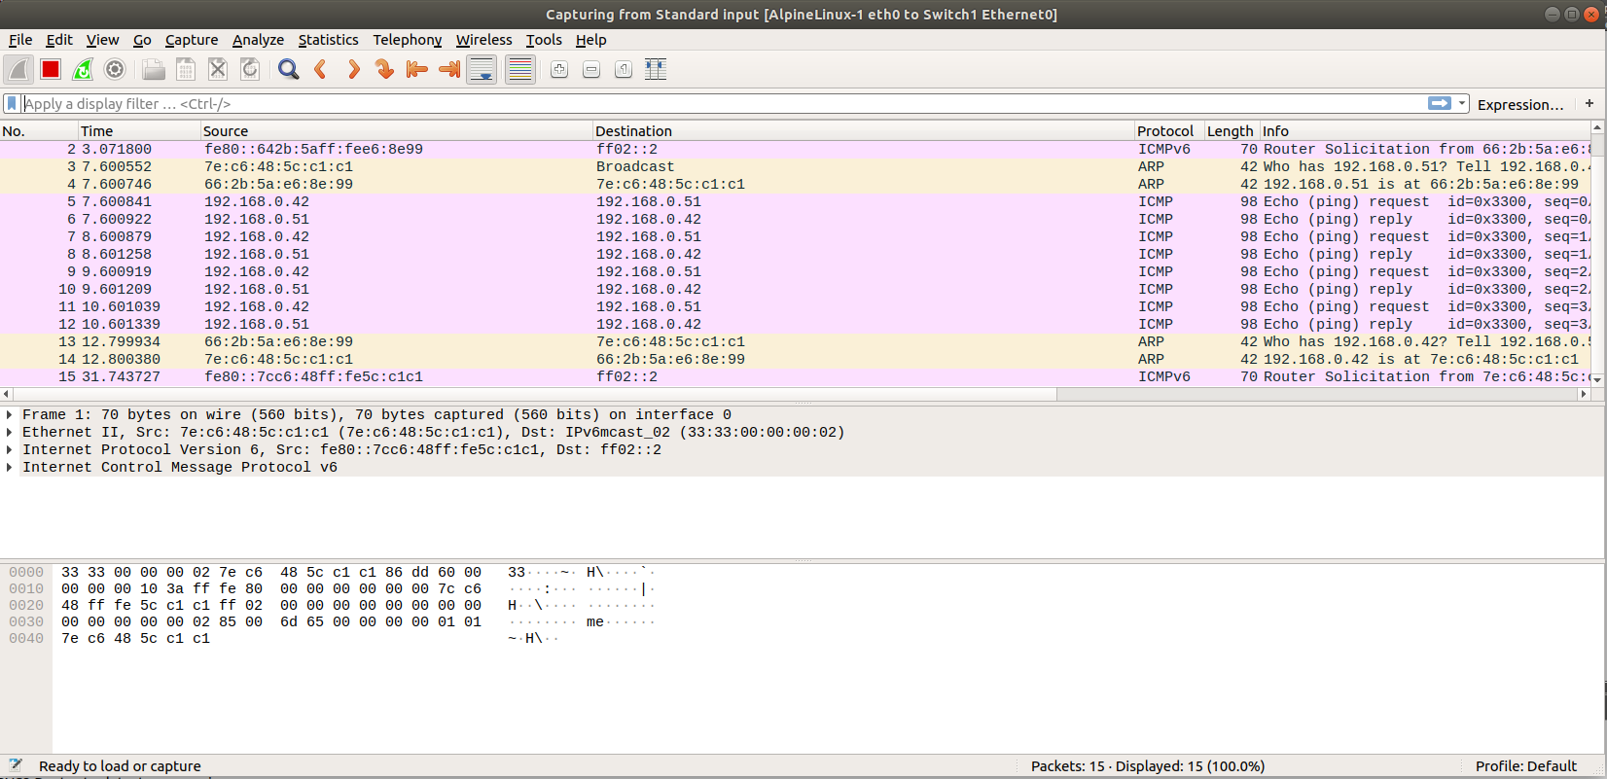
WIRESHARK

Slide 34
WIRESHARK
Wireshark can be used live or offline
Live: attached to an interface to display the traffic
Offline: a file is loaded (.pcap format)
Wireshark is well integrated in GNS3
right-click on a connection -> start capture

Slide 35
WIRESHARK
Consideration: Wireshark is not properly for pentesting
We can use it only to inspect the traffic of a network segment that we control
Our assumption is that the attacker only controls her/his own machine
Yet, local traffic may be interesting and relevant (man in the middle)
However, once we know the layer of interaction (e.g., application) we can use better, specialized tools to inspect the traffic (e.g., HTTP)
In particular, Wireshark is not the best tool for inspecting encrypted communications (e.g., HTTPS)

Slide 36
THE ROUTER

Slide 37
THE ROUTER
When using a switch, we have to insert the network cable of the PCs that we want to communicate with the other ones.
The need to use this new network device stems from the fact that we cannot remain confined within our subnet. In the future, we will need to communicate externally, i.e., on the Internet or with another subnet.

Slide 38
RELEVANT CONCEPT
The router's function is to transport the packets outside the subnet they originate from.

Slide 39
RELEVANT CONCEPT
Remember that we are dealing with IP addresses, not MAC addresses. A router operates at the network layer of the ISO/OSI model.

Slide 40
THE ROUTER
To give a practical example, let’s suppose that we are in a company with two distinct departments: the administrative and the technical one. Most likely these two will belong to different networks.

Slide 41
THE ROUTER
Let assume that we can count on two networks with the following settings:
Administration: network 192.168.1.0/24.
Technicians: network 192.168.2.0 /24.

Slide 42
THE ROUTER
All administration PCs will certainly have a switch that connects them and therefore will be able to talk to each other, and the same happens for the technical department.

Slide 43
THE ROUTER
But what if an administration PC wants to send a file to a technician's PC? It cannot do this, because they belong to different networks and the switch cannot establish a connection between different networks. It is in this case that the router comes into play.

Slide 44
THE ROUTER
This device will have its own interface connected to the 192.168.1.0/24 network and another one connected to 192.168.2.0/24. In this way, the two networks can communicate with each other.
A router may look similar to a switch, but its function is completely different.

Slide 45
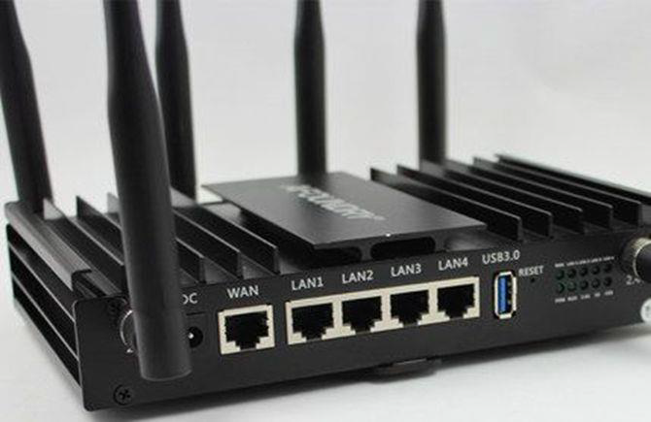
THE ROUTER

Slide 46
THE ROUTER
Besides, a router can allow us to connect to the Internet (as one would expect).

Slide 47
RELEVANT CONCEPT
The Internet itself is just a group of distinct networks.

Slide 48
THE ROUTER
Even in this case, I suggest you experiment with the router using GNS3. You must define a network architecture composed of some PCs, at least two SWITCHES and a ROUTER.

Slide 49
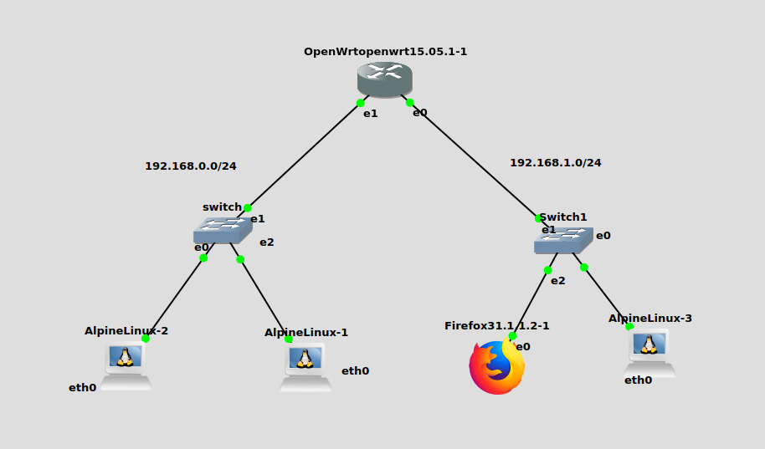
THE ROUTER

Slide 50
THE ROUTER
You will need to configure the IP addresses on the PCs and on the router by defining an IP address for each network interface used.
(Although the router also has DHCP server capability)

Slide 51
THE ROUTER
In this example I am using OpenWRT (an open, Linux-based router + firewall)
Things won’t work unless we configure addresses, routes and firewall rules

Slide 52
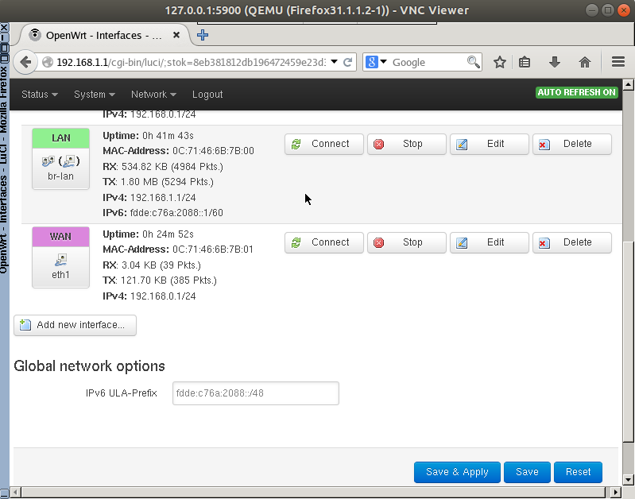
THE ROUTER
Setting static addresses
OpenWRT has a CLI called
Unified Configuration Interface (uci)
uci show
Instead we will use the Web UI
(browser needed!)
Notes:
uci set network.lan.ipaddr=192.168.0.1
uci set network.lan.proto='static'
uci set network.wan.ipaddr=192.168.1.1
uci set network.wan.proto='static'
uci commit && /etc/init.d/network restart

Slide 53
THE ROUTER
Setting a routes
Routes are automatically added when interfaces are activated!
We just need to provide interfaces with an IP address (e.g., static)
In case we need to add rules in the routing table from CLI
route
route add -net 192.168.0.0 netmask 255.255.255.0 dev eth1

Slide 54
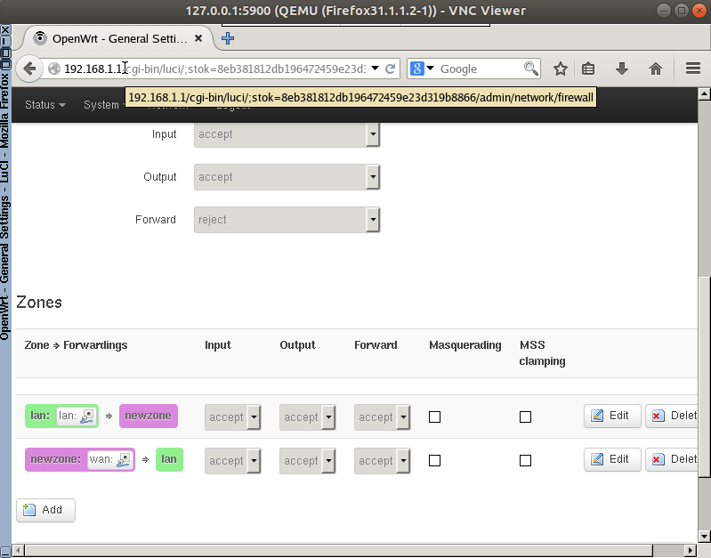
THE ROUTER
Allowing all the messages through the firewall
By default LAN => WAN
is allowed, but not the vice versa
We must add a rule for that
Notes:
iptables -L
iptables -F
iptables -P INPUT ACCEPT
iptables -P OUTPUT ACCEPT
iptables -P FORWARD ACCEPT

Slide 55
THE ROUTER
Nowadays, in addition to the need to communicate, we also look for a protection system for our network. It is for this purpose that I will introduce a new device: the FIREWALL
As you saw, router + firewall is often a single device (router-firewall)

Slide 56
THE FIREWALL

Slide 57
RELEVANT CONCEPT
The firewall is nothing but a router with advanced security features. By convention, we place the firewall between the upper end of the data layer and the lower end of the network layer.

Slide 58
THE FIREWALL
For this one, we will still have to manage MAC and IP addresses.
The main function of this device is to carry out packet filtering. It manages the traffic entering and leaving the network, and it is based on the concept of port and/or service.

Slide 59
THE FIREWALL
It also helps us to create security rules, which we will contribute to the overall “security policy”. We also need to decide what service, port, or application should be open or closed in our network.

Slide 60
THE FIREWALL
This device is often referred to as a “perimeter firewall” because its natural location is on the border of the internal network. This position allows it to protect our internal network from the outside world.

Slide 61
THE FIREWALL
In recent years, new security features have been added to the firewalls, so that sometimes they are called "Next Generation Firewalls".
Some of these features include URL filtering, application control, as well as the creation of VPNs, support to IPS and IDS.

Slide 62
THE FIREWALL
There are several types of firewall available. Some of them are free and meant for the domestic use.
Others are aimed at enterprises and can cost up to several thousands of euros.
Concepts are similar, but you can expect more functionalities from enterprise systems
Some of the main firewall vendors are:

Slide 63
THE FIREWALL
ENTERPRISE LEVEL FIREWALLS:
Checkpoint. Reference website: https://www.checkpoint.com/.
Paloalto. Reference website: https://www.paloaltonetworks.com/.
Fortinet. Reference website: https://www.fortinet.com/.
CISCO. Reference website: https://www.cisco.com/c/en/us/products/security/firewalls/index.html.

Slide 64
THE FIREWALL
PRIVATE FIREWALLS:
pfSense. Reference website: https://www.pfsense.org/.
OPNsense. Reference website: https://www.opnsense.org/.

Slide 65
FORTINET FIREWALL

Slide 66
FORTINET FIREWALL
Let's see how the Fortinet firewall looks like. Note that configuring a firewall in a business context is a complex operation, but the basic configurations are as follows:

Slide 67
FORTINET FIREWALL
Product installation.
Firmware/OS upgrade.
Configuration of network interfaces (LAN, WAN, DMZ).
Writing basic security policies.
Network traffic test.
Possible activation of advanced security features.

Slide 68
FORTINET FIREWALL
We can check the configuration of several network interfaces. We obviously need to have some IP addresses and define the LAN, WAN, DMZ network.

Slide 69
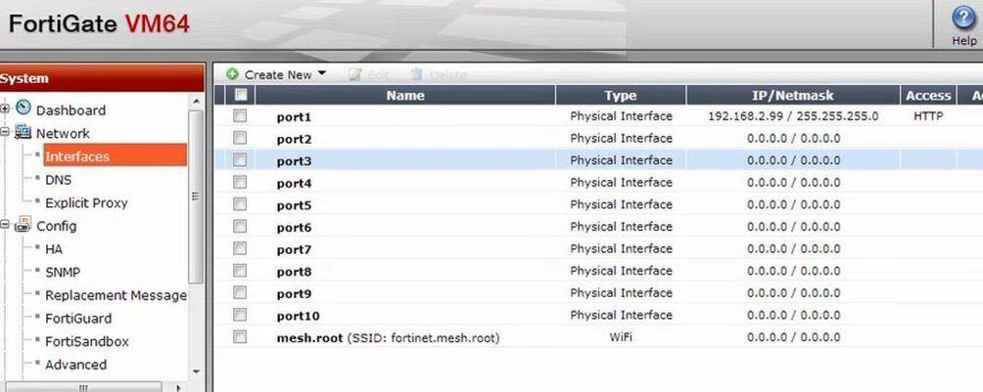
FORTINET FIREWALL

Slide 70
FORTINET FIREWALL
Writing of security policies: the first policy to be written in a firewall is the so called "cleanup rule", basically the last rule of the firewall.
(Yes, order matters in firewall rules...)
It blocks any type of traffic, unless otherwise specified by the higher policies. This is called a default:deny policy
In the configuration phase, it is always advisable to define a rule that accepts all traffic so as to verify that the network has been configured correctly.

Slide 71
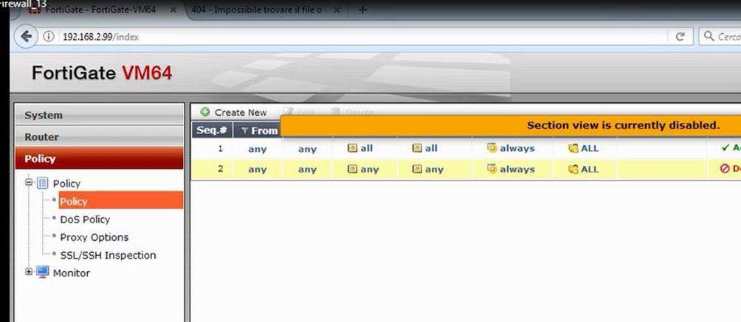
FORTINET FIREWALL

Slide 72
FORTINET FIREWALL
The firewall always works according to some criteria:
Source IP address.
Recipient IP address.
Port and/or service.

Slide 73
pfSense

Slide 74
pfSense FIREWALL
Free open source firewall based on FreeBSD

Slide 75
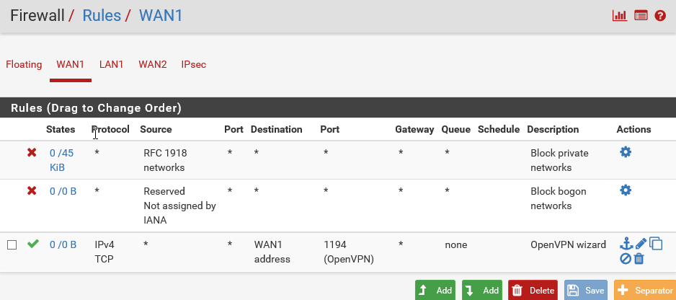
pfSense FIREWALL

